Slide 1
Supervised Learning - Foundations
Cars4U Project
Submitted by:
Naveen Pusuluri

Slide 2
Objective:
Explore the data and visualize using exploratory data analysis.
Build a linear regression model to predict the prices of used cars.
Generating a set of insights and recommendations which will help the company.
Data Information:
S.No. : Serial Number.
Name : Name of the car which includes Brand name and Model name.
Location : The location in which the car is being sold or is available for purchase Cities.
Year : Manufacturing year of the car.
Kilometers driven : The total kilometers driven in the car by the previous owner(s) in KM.
Fuel Type : The type of fuel used by the car (Petrol, Diesel, Electric, CNG, LPG).
Transmission : The type of transmission used by the car (Automatic / Manual).
Owner : Type of ownership.
Mileage : The standard mileage offered by the car company in kmpl or km/kg.
Engine : The displacement volume of the engine in CC.
Power : The maximum power of the engine in bhp.
Seats : The number of seats in the car.
New Price : The price of a new car of the same model in INR Lakhs(1 Lakh = 100, 000).
Price : The price of the used car in INR Lakhs (1 Lakh = 100, 000).
Observations | Variables
7253 | 14

Slide 3
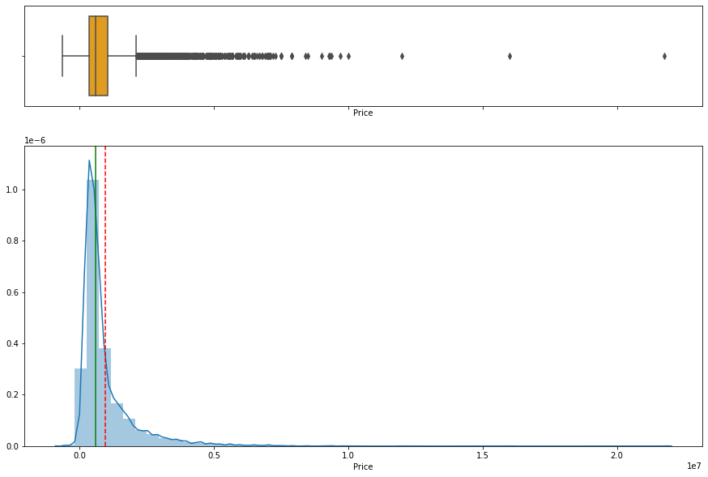
Exploratory Data Analysis:
Dependent Variable PRICE
Observations:
The price variable is rightly skewed, which means some of the used car prices are more than 10 Lakhs.
The mean price of a used car is between 8-9 Lakhs.

Slide 4
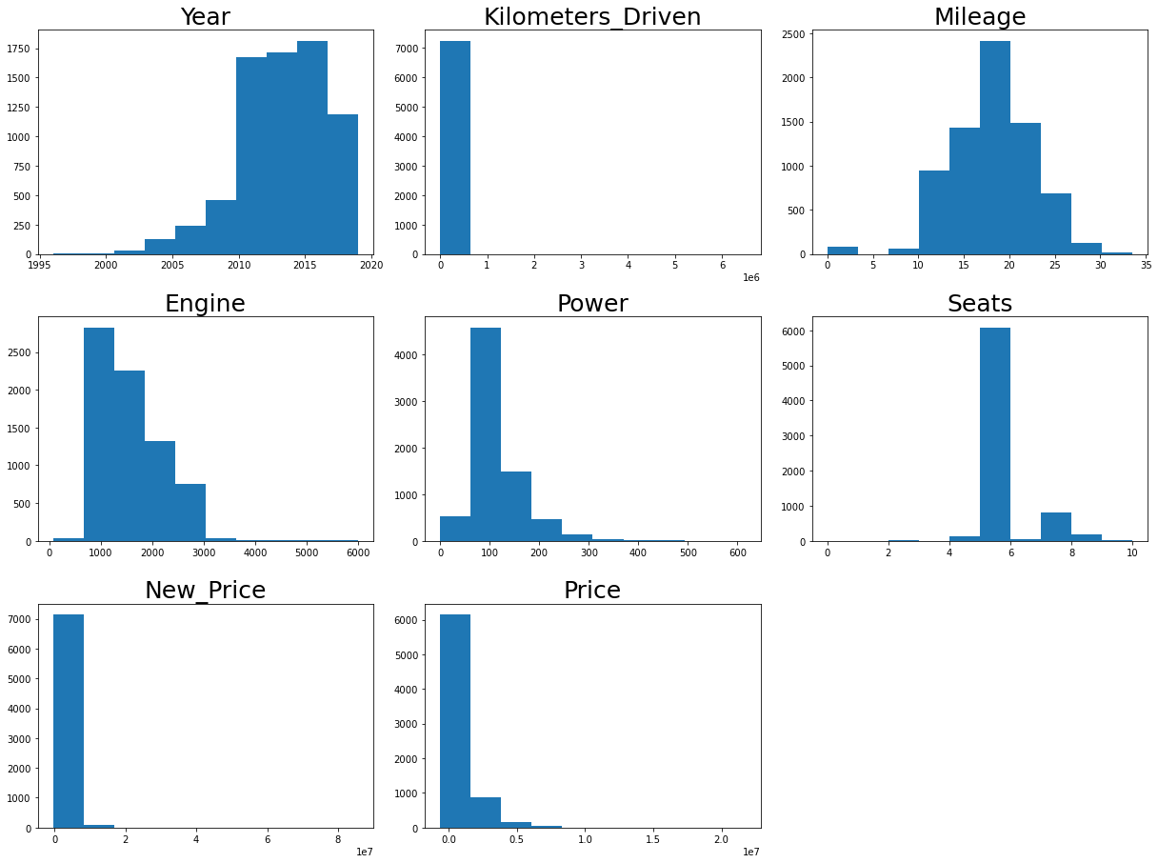
Exploratory Data Analysis:
Distribution of Numerical Variables
Observations:
Year variable is left-skewed, which means most vehicles are between 2010 and 2019.
Mileage has a normal distribution.
The engine has a somewhat normal distribution.
Most of the cars are five-seaters.

Slide 5
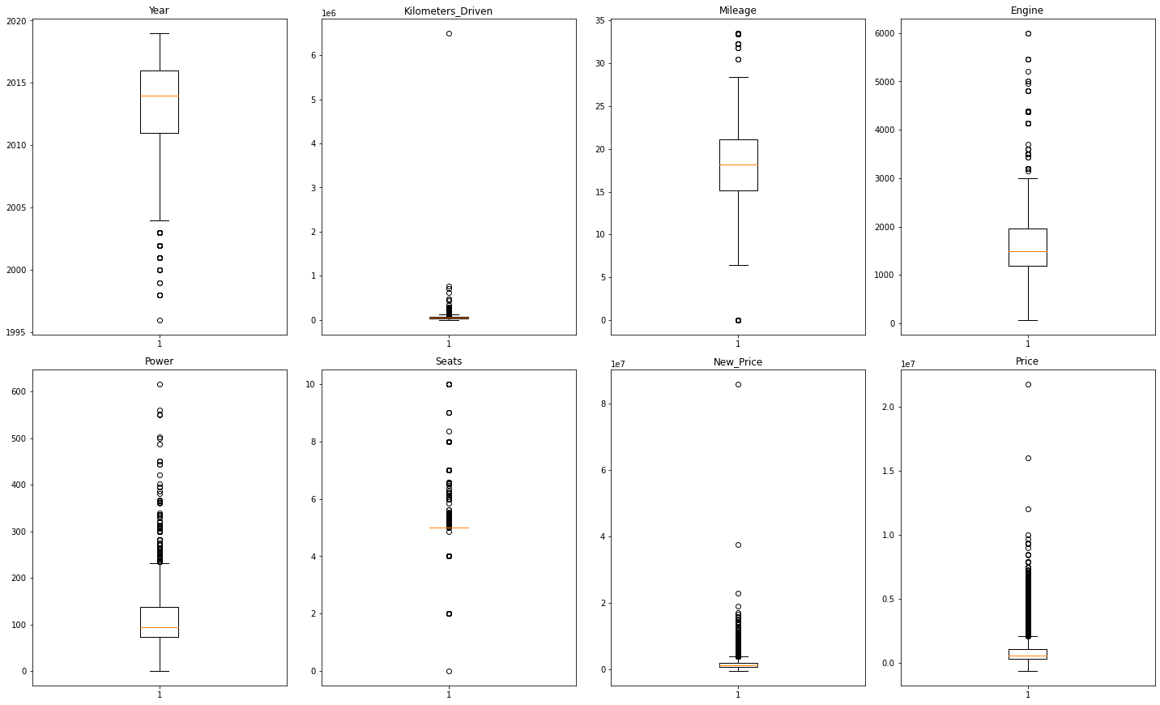
Exploratory Data Analysis:
Observations:
There are outliers in every numerical variable.
Year variables have lower outliers.
Mileage and seat variables have both upper and lower outliers.
All other numerical variables have upper outliers.
We need to treat these outliers for further analysis because these might affect the predictive power of the linear model.

Slide 6
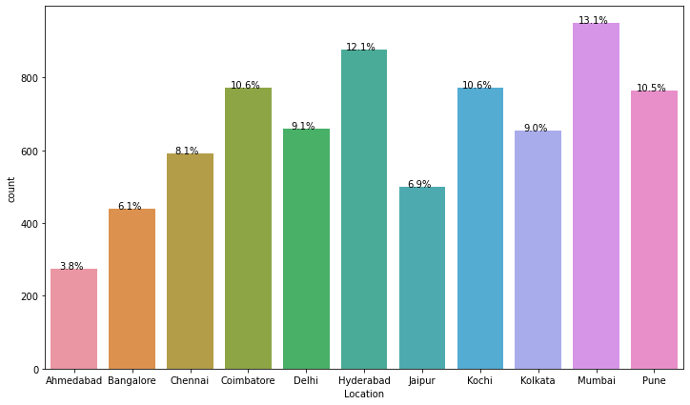
Exploratory Data Analysis:
Location
Observations:
The Mumbai region has the highest number of used cars for sale, followed by Hyderabad.
Kochi and Coimbatore stood in 3rd place.
Ahmedabad location has the least number of used cars for sale.

Slide 7
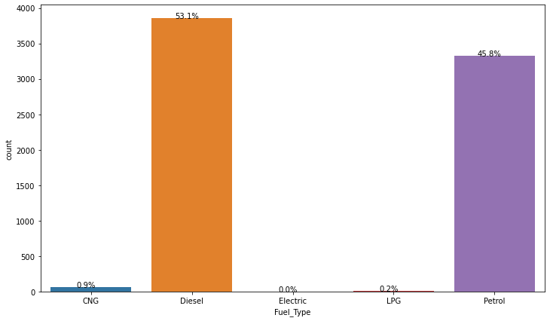
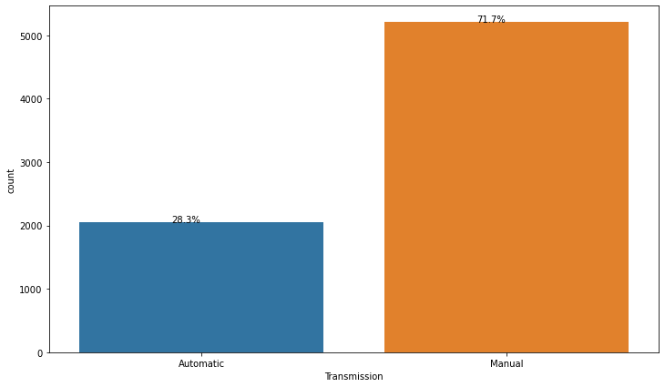
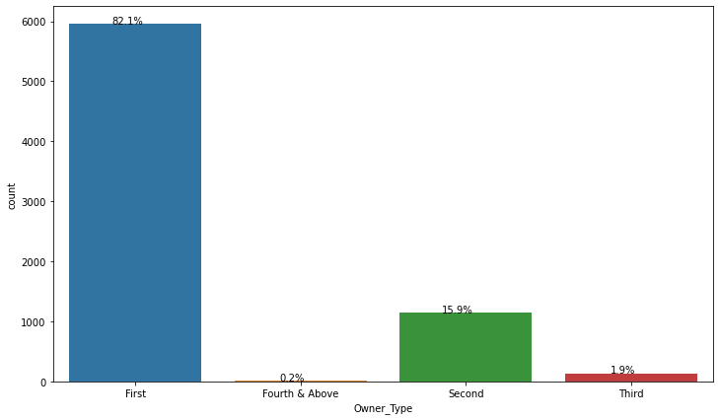
Exploratory Data Analysis:
Fuel Type
Transmission
Owner Type
Observations:
Among all fuel types, more than 50% of cars are diesel type cars followed by petrol type cars ~46%.
Observations:
In the given used cars data set, 71.8% of vehicles are manual transmission, and 28.3% of cars are Automatic transmission.
Observations:
Among the four owner types, 82% of the cars for sale are from the first owner, followed by the second owner with ~ 16%.

Slide 8
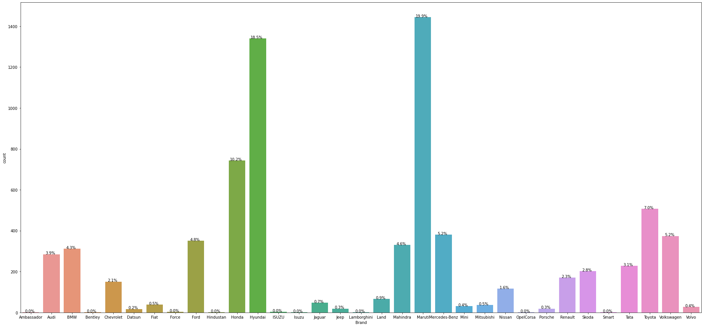
Exploratory Data Analysis:
Brand
Observations:
Among 33 car brands,20% of used cars for sale are Maruti car brands, followed by Hyundai with 18.5%.

Slide 9
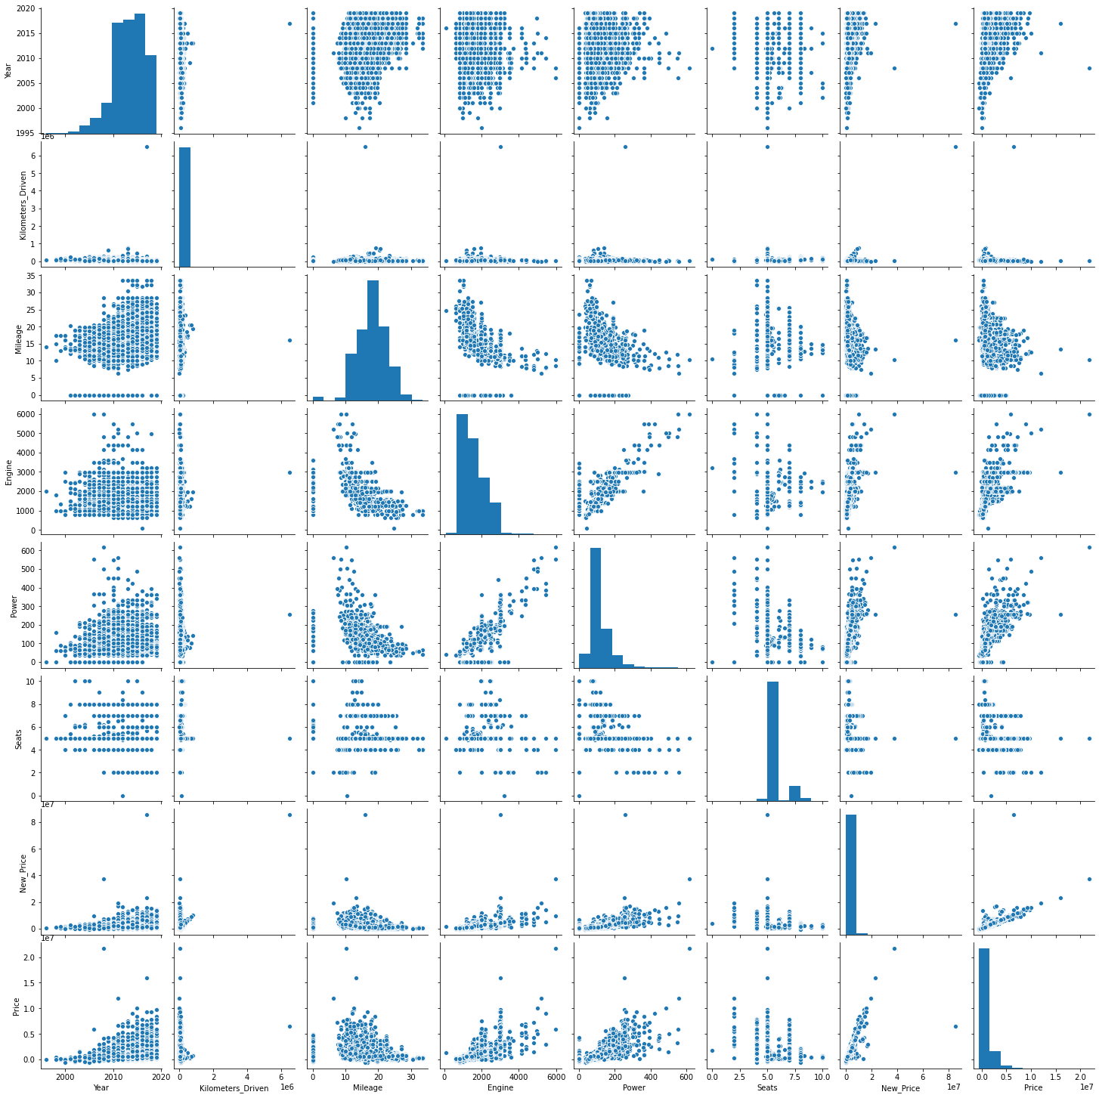
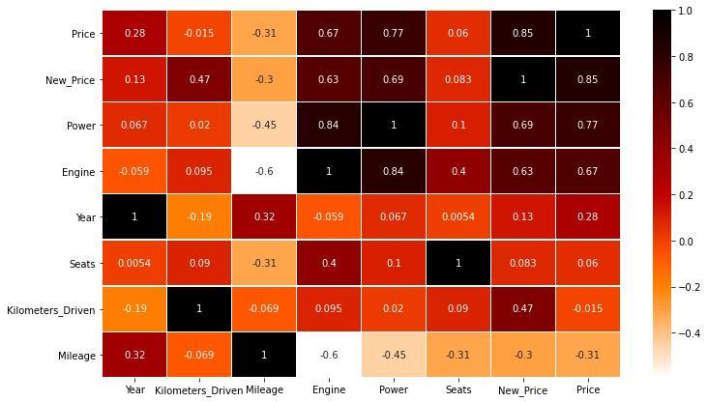
Exploratory Data Analysis:
Correlation Matrix
Observations:
Used car Price is negatively correlated with Mileage.
Used car price is highly correlated with New_Price followed by Power and Engine, which means the higher the power, and the engine higher the used car price.
Price is somewhat correlated with vehicle model year, and it has significantly less correlation with Kilometers_Driven and Seats.

Slide 10
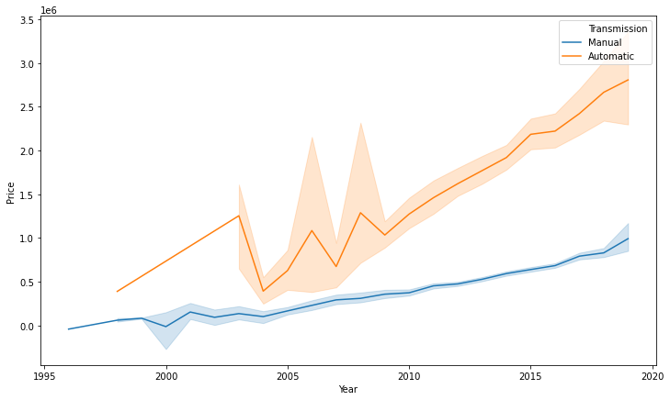
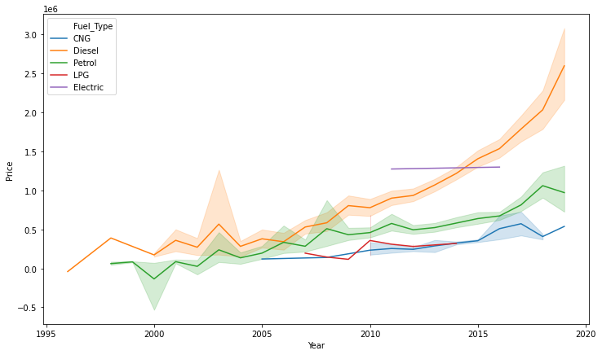
Exploratory Data Analysis:
Variables that are correlated with Price variable
Year Vs Price Vs Transmission
Year Vs Price Vs Fuel_Type
Observations:
As expected, the latest year model used cars' price are higher than older year models in which automatic transmission vehicle have a higher price than manual transmission vehicles.
Observations:
Among the five fuel types, the latest year model car prices are higher than previous models in which diesel vehicles have higher prices than other fuel type vehicles.

Slide 11
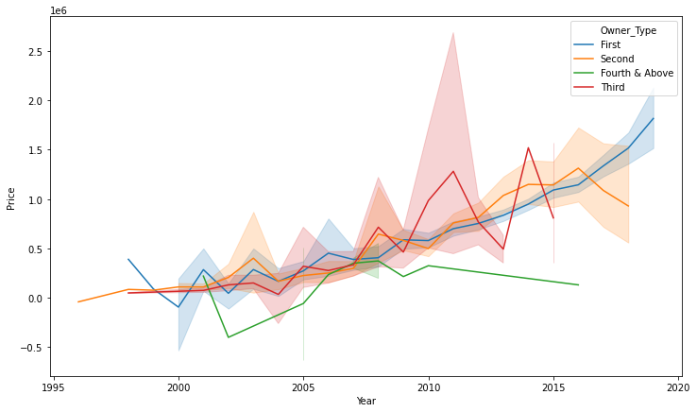
Exploratory Data Analysis:
Year Vs Price Vs Owner_Type
Observations:
Until the year 2016, both the first and second owner type car prices are almost equal, then after second owner type car prices have decreased significantly while the first owner type car price is increased.
From the year 2009 till 2012, third-owner-type vehicles have higher prices than other types, then prices started decreasing till the end of 2013 and then increased significantly in 2014 and then again started dropping in 2015.

Slide 12
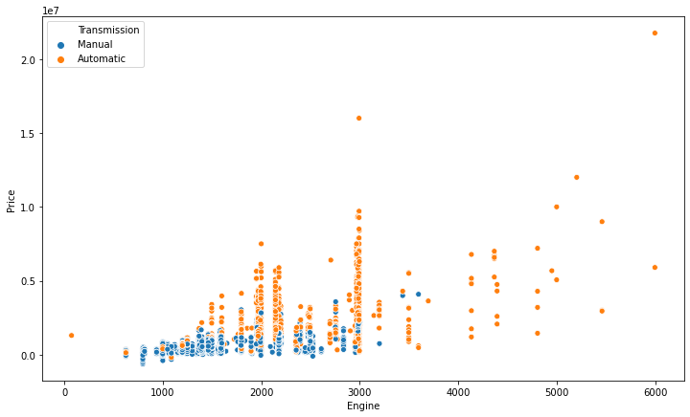
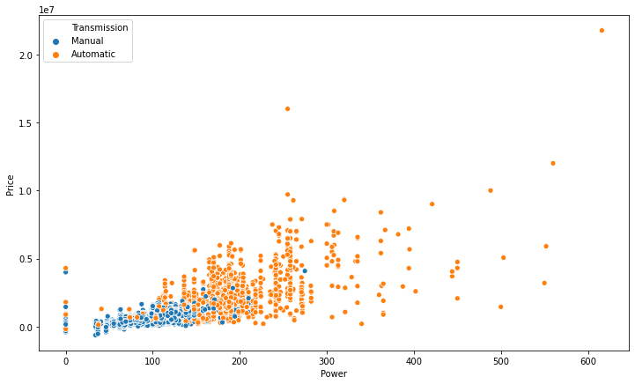
Exploratory Data Analysis:
Engine Vs Price Vs Transmission
Power Vs Price Vs Transmission
Observations:
Vehicles with more engine capacity have higher prices in which automatic transmission vehicles lead the used-car market than manual transmission vehicles.
Observations:
Vehicles with more power have higher prices in which automatic transmission vehicles lead the used-car market than manual transmission vehicles.
Most manual transmission vehicles are below 250 bhp in power.

Slide 13
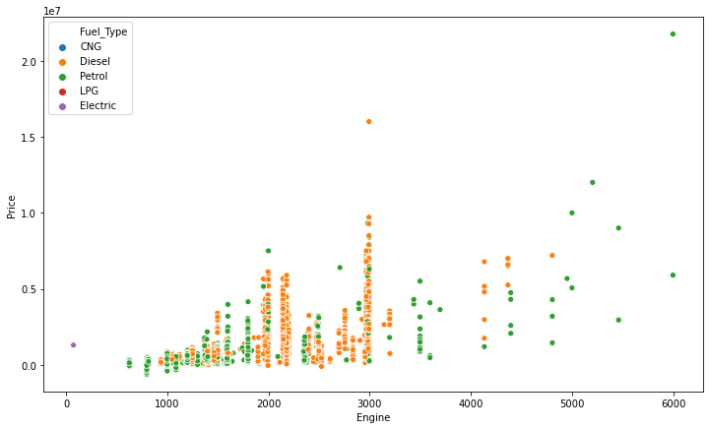
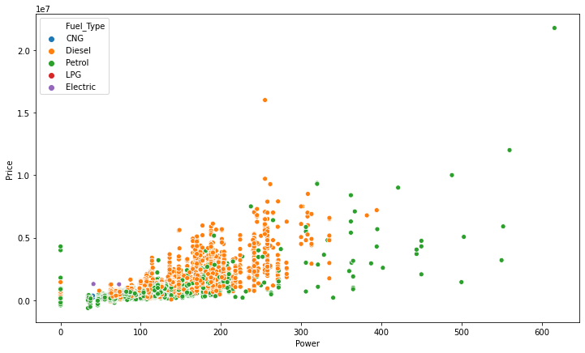
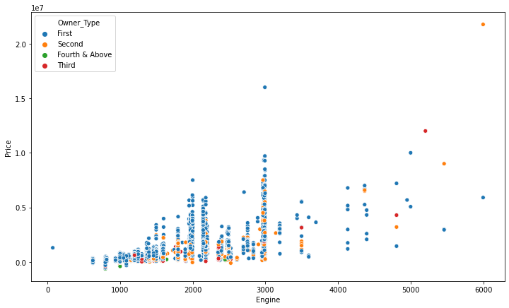
Exploratory Data Analysis:
Engine Vs Price Vs Fuel_Type
Power Vs Price Vs Fuel_Type
Power Vs Price Vs Fuel_Type
Observations:
Petrol fuel type cars have the highest engine power among five fuel type vehicles, followed by diesel type vehicles.
Observations:
Petrol fuel type cars have the highest horsepower among five fuel type vehicles, followed by diesel type vehicles.
Observations:
Among four owner-type vehicles, both first and second-owner-type cars are spread across all engine power(max 6000), where the highest number of vehicles are at 3000 Engine power.

Slide 14
Linear Regression Model
Dependent Variable = Price
Independent Variables = Year, Kilometers_Driven, Mileage, Engine, Power, Fuel_Type, Transmission, Owner_Type, Seats, Name, Location and Brand
Given below are values obtained after fitting a linear model on the training dataset.
Intercept of the linear equation: [804621.43262718]
Coefficients of the equation are: [[ 58846.8376592 -162450.94552708 -30621.69855254 17930.74949299 40292.89633916 493478.06310331 1675.47892628 7927.97089351 -1075.17297348 -27628.40549426 -15833.89867571 -5941.23688665 -1714.84727112 -1581.8036869 ]]
Observations:
If all the independent variables are 0, then the Predicted Price is ~ 8.05 Lakhs.

Slide 15
Linear Regression Model
Model Performances
Mean Absolute Error: 71715.64667904284
Observations:
Average difference between predicted and actual price is Rupees 71,715.65.
Root Mean Square Error: 122778.7032441567
Observations:
The standard deviation of the residuals(prediction errors) is 122,778.70(in rupees).
R2 Score: 0.9595587571867508
Observations:
R^2 value is 0.9595 which means that in this model independent variables can explain 96% of variances in dependent variable.

Slide 16
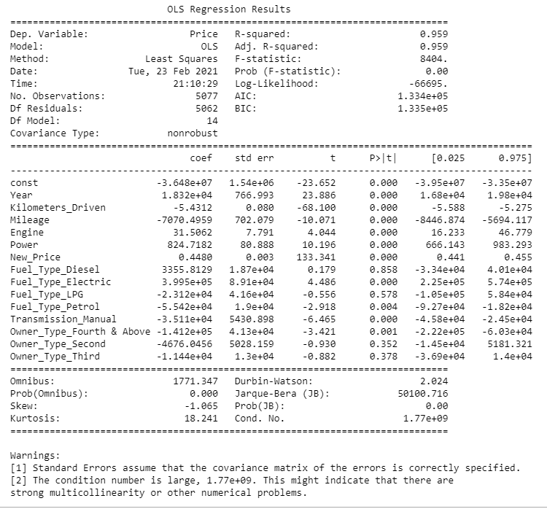
Linear Regression Model using Stats Model:
Observations:
The P-value of a variable indicates if the variable is significant or not. Suppose we consider the significance level to be 0.05 (5%), then any variable with p-values less than 0.05 would be considered significant.
Negative values of coefficient show that Price decreases with their increase.
Positive values of coefficient show that, Price increases with their increase.
Based on the P-value, Fuel_Type_Diesel,Fuel_Type_LPG,Owner_Type_Fourth&Above and Owner_Type_Second are not significant.

Slide 17
Linear Regression Model using Stats Model:
Interpreting the Regression Results:
Adjusted. R-squared: It reflects the fit of the model. R-squared values range from 0 to 1, where a higher value generally indicates a better fit. In our case, the value for Adj. R-squared is 0.959, which is good!
Std err: It reflects the level of accuracy of the coefficients. The lower it is, the higher is the level of accuracy.
Pr(>|t|) : For each independent feature there is a null hypothesis and alternate hypothesis
Ho : Independent feature is not significant
Ha : Independent feature is that it is significant
Pr(>|t|) gives P-value for each independent feature to check that null hypothesis. we are considering 0.05 (5%) as significance level
A p-value of less than 0.05 is statistically significant.
Confidence Interval: It represents the range in which our coefficients are likely to fall (with a likelihood of 95%)

Slide 18
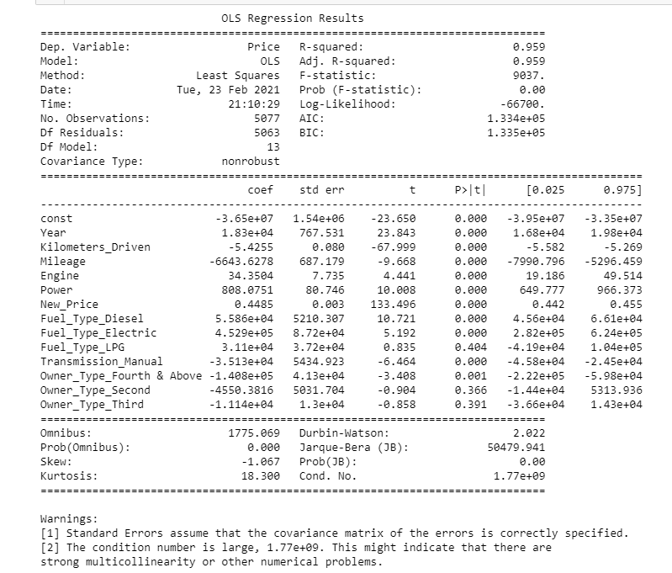
Linear Regression Assumptions:
No Multicollinearity:
After removing the variable (Fuel_Type_Petrol) with high VIF score, VIF has come down to quite a reasonable limit with all other variables, and now we can say features are not correlated.
Observations:
The R-squared value was the same on both the models, and it seems quite promising.
Fuel_Type_LPG, Owner_Type_Second and Owner_type_third have p-value greater than 0.05, so they are not significant. We will drop them.

Slide 19
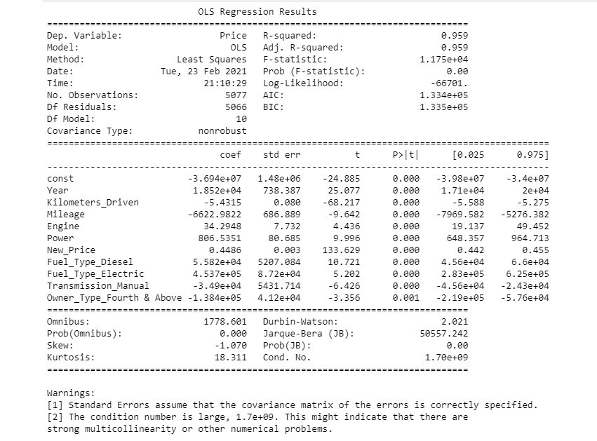
Linear Regression Assumptions:
Removed Fuel_Type_LPG, Owner_Type_Third and Owner_Type_Second features as the P value > 0.05.
Now no feature has p value greater than 0.05, so we'll consider features in X_train5 as the final ones and olsres4 as final model.
Observations:
It doesn't see any change in the Adjusted-R square value; our model can explain 96% of variance that shows the model is good.

Slide 20
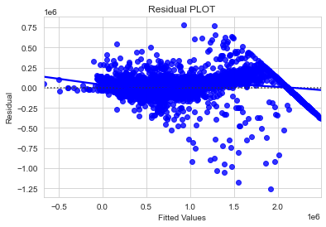
Linear Regression Assumptions:
2. Mean Of Residuals Should Be 0:
Mean of residuals value: -2.5856602646781747e-06
Observations:
Mean of residuals is close to 0.
3. Linearity Of Variables:
Observations:
The distribution of residuals (errors) vs fitted values (predicted values) shows the signs of non-linearity in the data.

Slide 21
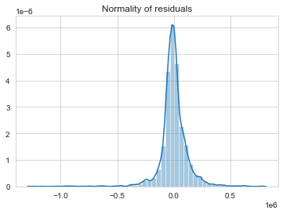
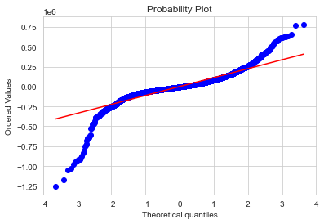
Linear Regression Assumptions:
4. Test for Normality:
Observations:
The plot is slightly left-skewed, which means residuals are not in normality.
The above QQ plot also shows that the data is not in normality.
Failed to prove that there is normality in the Normality. Hence the assumption got forgotten.

Slide 22
Linear Regression Assumptions:
4. No Heteroscedasticity:
Null hypothesis : Residuals are homoscedastic.
Alternate hypothesis : Residuals have heteroscedasticity.
[('F statistic', 1.1877414299298936), ('p-value', 7.735678458888181e-06)]
Observations:
Since p-value < 0.05, we can say that the residuals are Heteroscedasticity.
Failed to prove that there is no heteroscedasticity in the data. Hence the assumption got forgotten.
Performance on train and test: metric used - RMSE
Observations:
Now we can finally see that we have high test and train error.
Hence, we can conclude the model is not suitable for prediction and inference purposes.
Train error: 122867.12092074181
Test error: 122705.28130905375

Slide 23
Conclusion:
As all the assumptions are not satisfied, we cannot conclude that the predicted values are correct. Hence the given data set is not suitable for the linear regression model; we must check with other machine learning models.
Cannot provide any recommendations depending on the linear regression model without applying other machine learning models to the given data. The linear regression model is not suitable for the given data set.

